Slide 1

Malignant Comments Classification
Created By
Jayashri Dandare

Slide 2
Problem Statement
The proliferation of social media enables people to express their opinions widely online. However, at the same time, this has resulted in the emergence of conflict and hate, making online environments uninviting for users. Although researchers have found that hate is a problem across multiple platforms, there is a lack of models for online hate detection.
Online hate, described as abusive language, aggression, cyberbullying, hatefulness and many others has been identified as a major threat on online social media platforms. Social media platforms are the most prominent grounds for such toxic behavior.
Our goal is to build a prototype of online hate and abuse comment classifier which can used to classify hate and offensive comments so that it can be controlled and restricted from spreading hatred and cyberbullying.

Slide 3
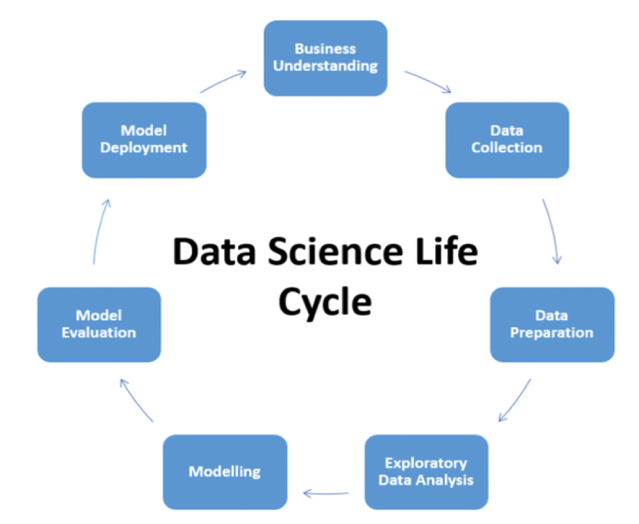

Slide 4
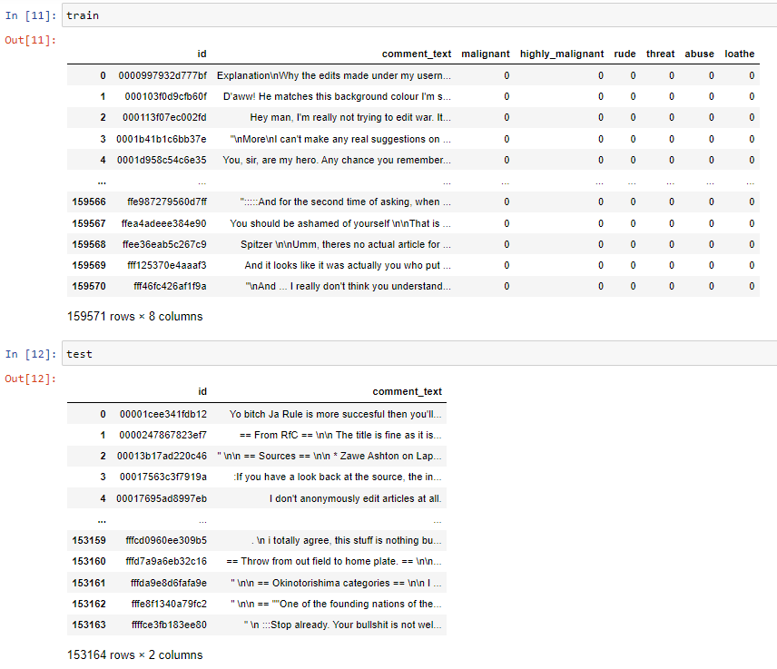
Data Collection & Description
The data was provided by FlipRobo in CSV format. After loading the training dataset into Jupyter Notebook using Pandas and using df.head() it can be seen that there are eight columns named as “ id, comment_text, “malignant, highly_malignant, rude, threat, abuse, loathe”. Similarly, the test file can be load using pandas and the first five rows of the dataset can be seen using df.head() method.

Slide 5
Preprocessing Of The Data
We have performed the following preprocessing on the data:
Removed punctuations
Removed the stop words
Stemming and lemmatization
Applied counter vectorizer

Slide 6
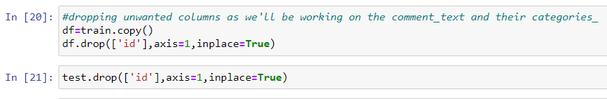
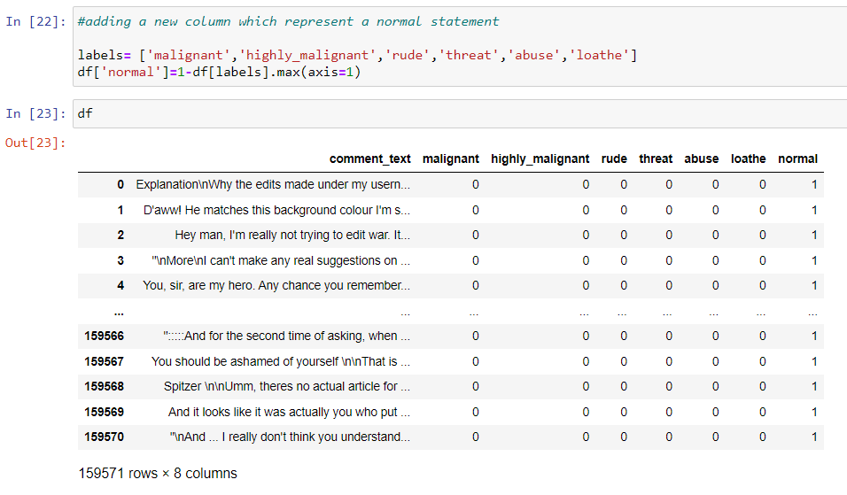
Data Pre-processing Done:
After the dataset is loaded and the shape, null values and duplicated values were checked then the data- set is further treated where the unwanted column “id” is removed from the training dataset as we will work on the columns like “comment_text, “malignant, highly_malignant, rude, threat, abuse, loathe”. So a copy of the training dataset was made using df.copy() and the column was dropped from the new dataset using df.drop(). Similarly, the ‘id’ column is also dropped from the test dataset.
After removing the unwanted column, a new column named ‘normal’ was created in the training dataset which represents the statements not falling under malignant, highly_malignant, rude, threat, abuse, loathe category or statements where values of malignant, highly_malignant, rude, threat, abuse, loathe are 0.

Slide 7
Data Description
Project contain train and test dataset.
In train data set there are 159,571 rows and 8 columns.
In test data set it is like 153,164 rows and 2 columns.
There are no null values in the dataset
Most of the data are numeric in nature which are binary.
Comments is object in nature and consist of text.
Overall memory usage for train and test is around 15MB.

Slide 8
Data Cleaning
As there are null values in the dataset, but as the comment column in text format so there require lot of text - preprocessing.
Percentage of unlabelled comments is 89.83 %.

Slide 9
Creating Model
For solving this project I used various model like Logistic Regression, SVM, Random Forest etc.
For text preprocessing I used TFIDF .
Also used hyperparameter tunning and calculate the scoresand select the best model from all.

Slide 10
Metrics : Accuracy, Confusion Matrix
In classification problem there are various metrics that are accuracy score, confusion matrix, classification repot, Roc Auc curve which help to check the efficiency of the model
Which metrices is useful? Is also depend and vary on domain, so as per the use case we must predict that whether the customer is defaulter or not
So, in this case accuracy score is good but most important is confusion matrix in which we must decrease the False Positive that is type 2 error which is provided by Logistic Regression.

Slide 11
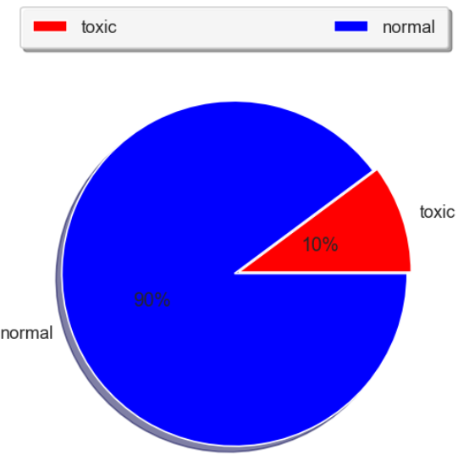
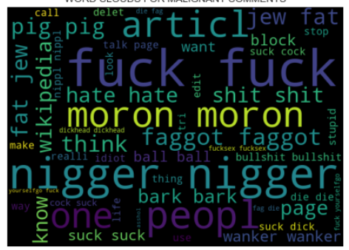
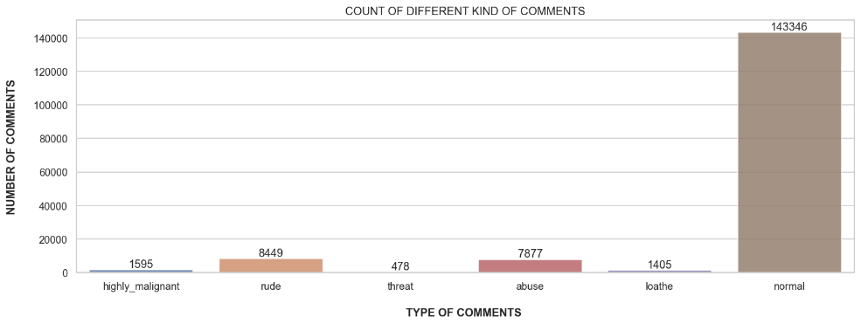
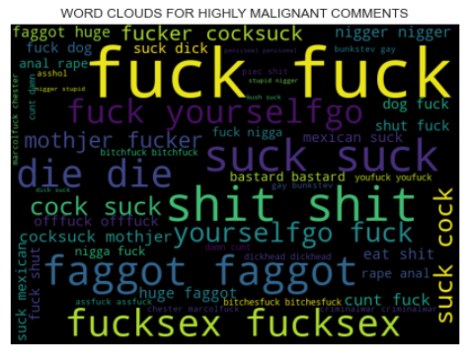
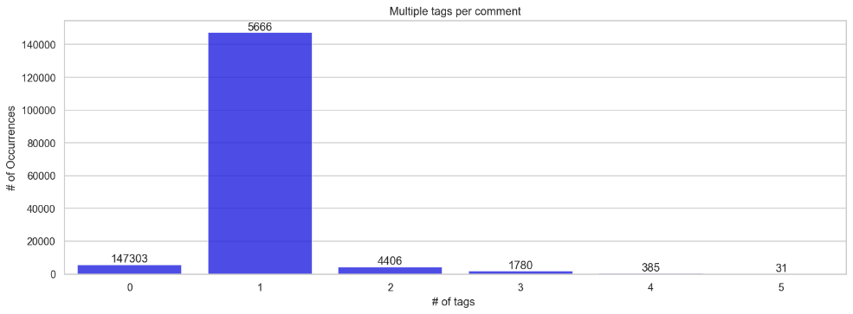
Visualizations:
Visualization plays a crucial role in EDA as well as during modelling. It gives a better idea about the things going on beautifully. Below are the few visualizations used during this project to understand the dataset and performance of the algorithms.

Slide 12
CONCLUSION

Slide 13
Key Findings and Conclusions of the Study:
From the above analysis the below mentioned results were achieved which depicts the chances and conditions of a comment being a hateful comment or a normal comment; o With the increasing popularity of social media, more and more people consume feeds from social media and due differences they spread hate comments to instead of love and harmony. It has strong negative impacts on individual users and broader society.

Slide 14
Limitations of this work and Scope for Future Work
Every effort has been put on it for perfection but nothing is perfect and this project is of no exception. There are certain areas which can be enhanced. Comment 3 7 MALIGNANT COMMENTS CLASSIFICATION detection is an emerging research area with few public datasets. So, a lot of works need to be done on this field.

Slide 15


